Slide 1
Chapter 4
Styling in React

Slide 2
Objectives
Displaying Some Vowels
Styling React Content Using CSS
Understand the Generated HTML
Styling Content the React Way
Creating a Style Object
Actually Styling Our Content
Making the Background Color Customizable

Slide 3
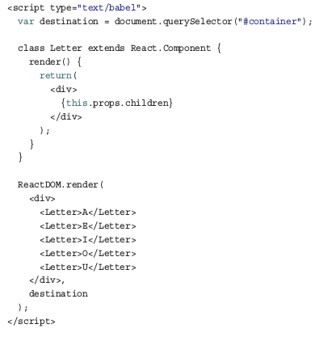
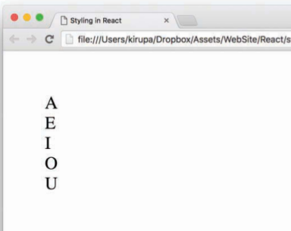
Displaying Some Vowels
To display the vowels, you need to add some React-specific code. Just below the container div element

Slide 4

Displaying Some Vowels
Don’t worry, you’ll make it look a little less boring in a few moments. After you’ve had a run at these letters

Slide 5
Styling React Content Using CSS
Using CSS to style React content is actually as straightforward as you can imagine it to be.
Because React ends up spitting out regular HTML tags, all of the various CSS tricks you’ve learned over the years for styling HTML still apply. You just need to keep a few minor points in mind.

Slide 6
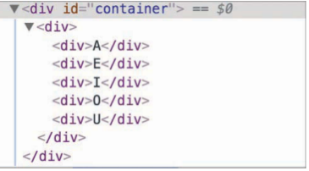
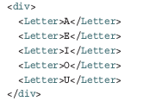

Understand the Generated HTML
The parent render method is our ReactDOM -based one, and it looks as follows
We have our various Letter components wrapped inside a div .
The final DOM structure

Slide 7
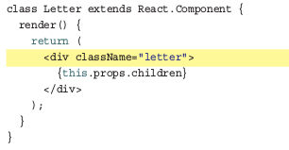
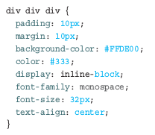
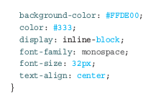

Just Style It Already!
Understand the HTML arrangement of the things you want to style, the hard part is done.
We address this by giving our inner div elements a class value of letter

Slide 8
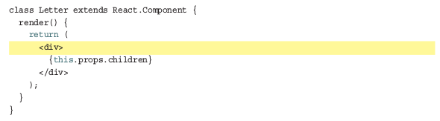
Styling Content the React Way
React favors an inline approach for styling content that doesn’t use CSS. That might seem a bit strange at first, but it’s designed to make your visuals more reusable. The goal is to make your components little black boxes where everything related to how your UI looks and works is stashed.

Slide 9
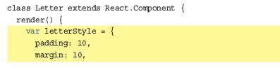
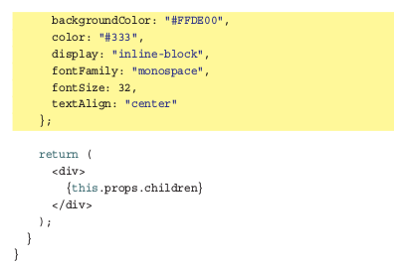
Creating a Style Object
JavaScript (by setting object.style ), the formula for converting them into something JavaScript-friendly is pretty simple:
1. Single-word CSS properties (such as padding , margin , and color) remain unchanged.
2. Multiword CSS properties with a dash in them (such as background-color, font-family, and border-radius ) are turned into one camel-case word, with the dash removed and the first letter of the second word capitalized.

Slide 10
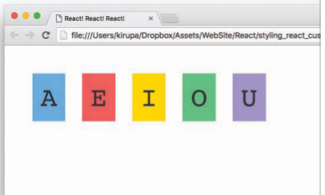
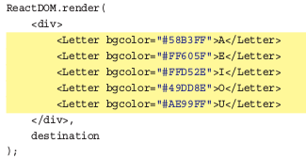
Actually Styling Our Content
To do this in our ReactDOM.render method, first add a bgcolor attribute and specify some colors, as shown in the following highlighted lines:
Next, we need to use this property. In the letterStyle object, set the value of backgroundColor to this.props.bgColor

Slide 11
Apply Styling in Component
You can apply CSS into React following 3 ways (same as HTML):
Inline style: (not recommend)
<div style={{color: ‘red’, fontSize: 14}}></div>
Internal style:
const textStyle = {color: ‘red’, fontSize: 14};
<div style={textStyle}></div>
External style:
import ‘./style.css’;
<div className=’textClass’ ></div>

Slide 12
Conclusion
In this tutorial, you saw React promoting inline styles in JavaScript as a way to style content instead of using CSS style rules. Earlier, we looked at JSX and showed how to declare the entirety of your UI in JavaScript using an XML-like syntax that sort of, kind of looks like HTML.
HTML, CSS, and JavaScript techniques that probably made a lot of sense when dealing with web pages and documents might not be applicable in a web-app world where components are reused inside other components.
You can use css or scss to style component in React. It’s up to you. There are many UI libraries which support you in styling very well, for example: Bootstrap, Material UI, Ant Design,... or styled-components.

